Slide 1
Power Bi
Introduction to the Data:
This analysis involves comprehensive data collected from customer records, including information related to their contracts, monthly charges, tenure, and payment methods. The data encompasses a variety of services offered by the company, such as fiber optic and DSL, and illustrates how customers interact with these services.

Slide 2
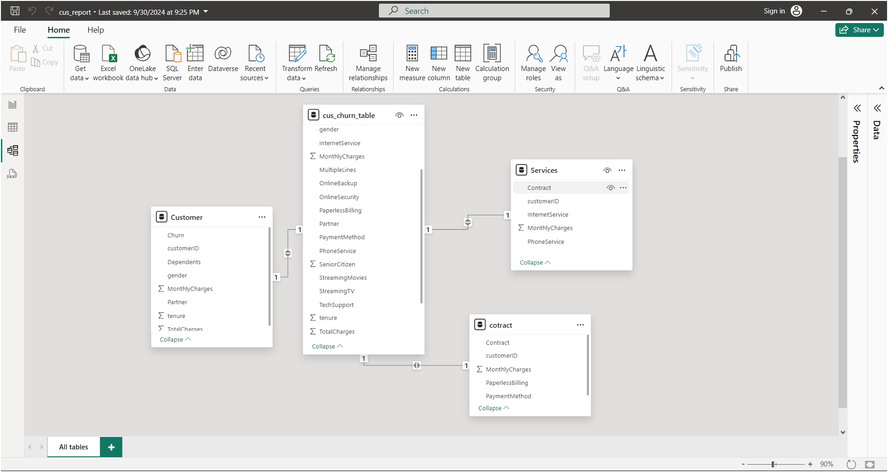
1.Data model
"This is a Power BI report showing the relationships between different tables, all focused on analyzing customer churn (basically, why customers leave).
There are four tables:
Customer: Basic customer info like gender, churn status, and monthly charges.
cus_churn_table: Extra customer details, like services and device protection.
Services: What services the customer is using, like phone and internet.
contract: Info about the contracts, including payment methods.
These tables are linked by the customer ID, so we can combine data to analyze why customers are leaving. It’s all about finding patterns and figuring out how to keep customers happy!" 😊

Slide 3
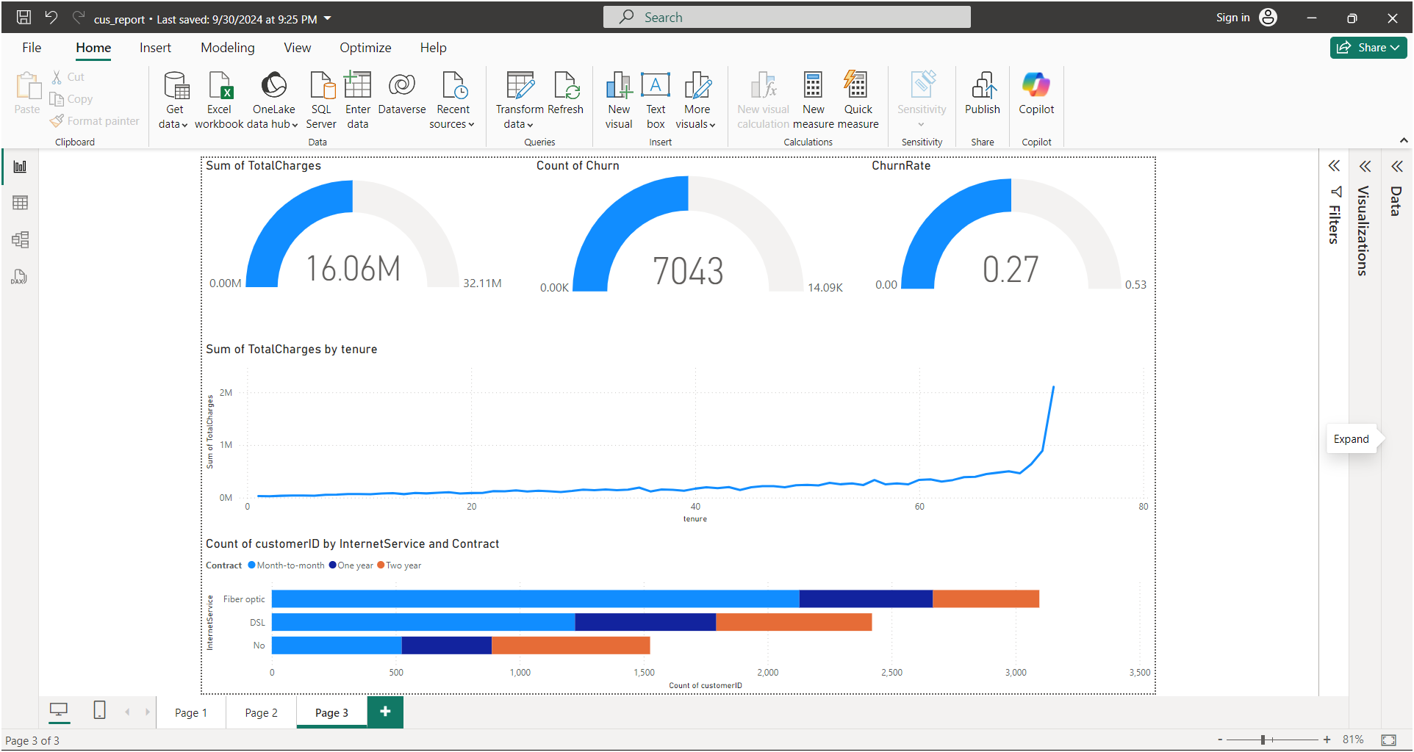
Customer Dashboard Summary
Total Charges: The total charges from customers have reached 16.06 million, with potential growth up to 32.11 million.
Churned Customers: A total of 7,043 customers have churned, leading to a churn rate of 0.27 (27%).
Total Charges by Tenure: While total charges remain stable for most customers, there’s a significant increase for long-term customers (those with over 80 months of service).
Customer Distribution by Internet Service and Contract Type: Fiber optic customers mostly prefer month-to-month contracts, while DSL customers show a more balanced distribution between monthly and long-term contracts.
Recommendations:
Focus on increasing loyalty among long-term customers.
Reduce the churn rate, with particular attention to month-to-month contracts.
Offer targeted promotions to encourage long-term contracts based on the type of internet service.

Slide 4
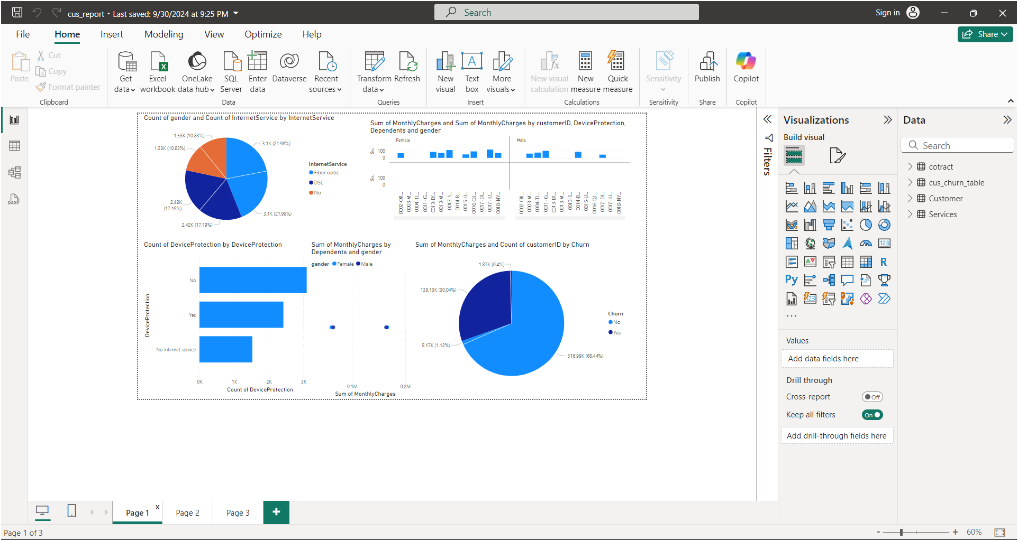
Slide 1: Customer Behavior Analysis by Contract and Service Type
1. Churn Rate by Contract Type:
Most cancellations are from customers with month-to-month contracts compared to those with one-year and two-year contracts. Customers with monthly contracts show a higher likelihood of churn.
2. Tenure Distribution:
The graph shows that customers with longer-term contracts (like two years) tend to stay longer compared to those with monthly contracts.
3. Monthly Charges by Contract Type:
Customers with month-to-month contracts tend to pay significantly higher monthly charges compared to those with one-year or two-year contracts.
4. Payment Methods by Churn and Senior Citizens:
The analysis shows that senior citizens tend to use specific payment methods more than others. There is also a variation in churn likelihood based on the payment method used.

Slide 5
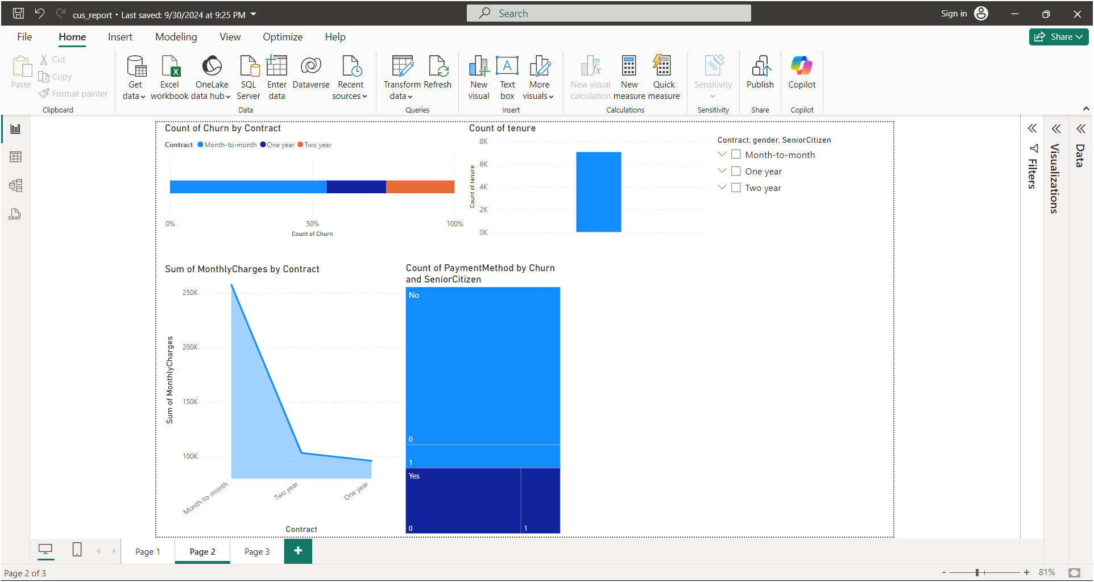
Slide 2: Detailed Analysis of Monthly Charges and Churn
1. Service Distribution by Type and Gender:
The pie chart shows that the majority of customers prefer fiber optic internet services, followed by DSL. There is a balanced distribution of internet service use between genders.
2. Device Protection:
A large proportion of customers have device protection, but there is also a significant number who do not use this service.
3. Monthly Charges by Gender and Dependents:
The graph shows the distribution of monthly charges between males and females, with slight variations based on the presence of dependents.
4. Churn by Monthly Charges:
The pie chart illustrates that the majority of churn occurs among customers with lower monthly charges, while customers with higher charges are less likely to cancel their subscriptions.

Slide 6
General Recommendations:
Focus on Month-to-Month Customers: As they represent the highest churn group, retention strategies should be enhanced with special offers or improved services for this segment.
Enhance Experience for Senior Citizens: With different payment preferences and favored services, senior citizens may benefit from customized offers or support to increase loyalty.
Market Device Protection Service: Given that some customers do not use device protection, promoting this add-on service could attract more customers and reduce churn.
Target Customers with Lower Monthly Charges: Offering service upgrades or discounts to these customers can improve retention and decrease the churn rate.

